Slide 1
Video Workshop
Rich Cottone
Doctoral Student
Rem Jimenez
Doctoral Student

Slide 2
Recent Statistics About Video
74% of all internet traffic in 2017 will be video
65% of video viewers watch more than 3/4 of a video
69% of smartphone users say videos are a perfect solution for smartphone viewing as it offers a quick way for consumers to grasp an overview of a product
Facebook announced that they are generating 8 billion video views per day,
Snapchat announced they are doing 6 billion views per day.
YouTube says they gets 4 billion views per day… and expect to get 500 Hours of Video Uploaded To YouTube Every Minute in 2016.
Syndicast (2014) “Video Marketing Trends 2015.” Retrieved from http://syndacast.com/video-marketing-statistics-trends-2015/
Source: 500 Hours of Video Uploaded To YouTube Every Minute [Forecast] http://www.reelseo.com/hours-minute-uploaded-youtube/#ixzz41gfU4Ncn ©ReelSEO.com, All Rights Reserved

Slide 3
Why video?
Research from a broad spectrum of educational environments has reported a motivational effect on children when digital video was integrated into the classroom (Goldman, 2004; Kearney and Schuck, 2006).
Schwartz and Hartmann (2007) note that the use of video ‘can help people bring to bear relevant knowledge to raise interest and make sense of subsequent instruction’ (Schwartz and Hartmann, 2007 p. 10).
When they are carefully designed, videos can be used to add meaning and relevance to abstract spatial, temporal and causal phenomena and/or concepts (Quellmalz, Timms, Silberglitt & Buckley, 2012).
Quellmalz, E. S., Timms, M. J., Silberglitt, M. D. & Buckley, B. C. (2012). Science assessments for all: Integrating science simulations into balanced state science assessment systems. Journal of Research in Science Teaching, 49(3), 363–393.
Schwartz DL and Hartman K (2007) It is not television anymore: designing digital video for learning and assessment. In: Goldman R, Pea R, Barron B, et al. (eds) Video Research in the Learning Sciences. Mahwah, NJ: Lawrence Erlbaum Associates, pp. 335-348.

Slide 4
Why Video (Continued)
Videos have the advantage that they can be paused, rewound and replayed as needed. This increases the opportunities teachers have to focus and guide students to attend to events that might go unseen in real time (Tversky & Morrison, 2002).
Digital video feedback allowed for the viewing of motor skills repeatedly and in slow motion thus providing visual feedback and allowing students to understand in what ways they were performing (O’Loughlin, Chroinin, & O’Grady, 2013).
O’Loughlin, J., Chróinín, D. N., & O’Grady, D. (2013). Digital video: The impact on children’s learning experiences in primary physical education. European Physical Education Review, 19(2), 165-182.

Slide 5
Platforms for Teachers to Create/Use Video
One – Take Videos & Streaming
Your Phone
Digital Camera
Audio Slides Videos
Animoto
Shadowpuppet.edu
Whiteboard/ Screen Cast
Screencast-O-matic
YouTube
iMovie
IPad/ Tablet
Windows Movie Maker
PowerPoint
Skype
Animated Videos
Stop Motion Videos
Documentary / Film Feature
FaceTime
Clarisketch
Pixiclip
Screenchomp
Knowmia Teach
Tellagami
Wideo
Scratch
IMovie
Windows Movie Maker
JellyCam
Osnap
ParaPara Animation
WeVideo (Chrome-book users)
Courtesy of Richard Byrne FreeTech4Teachers.com

Slide 6
Some Strategies to Consider
Flipped Classroom
Video Blogs / Journals
Informational Video
Problem Based Learning
Live Video Streams
Video As Scaffolding
Case studies – anchored instruction

Slide 7
MODELS OF TEACHING AND INCORPROATING VIDEO INTO THE CLASSROOM

Slide 8
Model for Teaching and Learning with Digital Video
Schwartz and Hartmann (2007) present a model for teaching and learning with digital video, where the four major learning outcomes for learning with digital video are:
Engaging: Children engage in learning with video when it shows relevant knowledge to raise interest and make sense of subsequent instruction.
Doing: Video can also present human behaviors (the ‘doing’).
Seeing: They describe video as a means of helping people see things that are new to them or familiar things demonstrated in a different way.
Saying. Lastly, they stress that audio knowledge (‘saying’) can be gleaned from digital video.
Schwartz DL and Hartman K (2007) It is not television anymore: designing digital video for learning and assessment. In: Goldman R, Pea R, Barron B, et al. (eds) Video Research in the Learning Sciences. Mahwah, NJ: Lawrence Erlbaum Associates, pp. 335-348.

Slide 9
Schwartz DL and Hartman K (2007) It is not television anymore: designing digital video for learning and assessment. In: Goldman R, Pea R, Barron B, et al. (eds) Video Research in the Learning Sciences. Mahwah, NJ: Lawrence Erlbaum Associates, pp. 335-348.

Slide 10
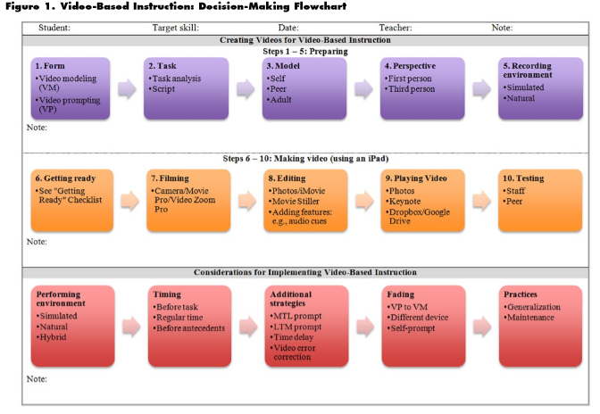
Before you create the video
Weng, P., Savage, M. N., & Bouck, E. C. (2014). iDIY: Video-based instruction using iPads. TEACHING Exceptional Children, 47(1), 11-19.

Slide 11
WHEN DO YOU USE IT?

Slide 12
Using Video
Pre-Work
Flipped Instruction
Review General Information
In Class
To catalyze dialog between students
To model steps and instructions
Post Class
Reinforcement & Remediation
Demystify more complex topics
As a scaffolding tool
To model steps and instructions
To record student actions and offer feedback
Real Time Video from external expert

Slide 13
Flipped instruction

Slide 14
Video Modeling and Video Self-Modeling
Video modeling - an instructional technique that involves a student watching a video of a model (e.g., a peer or adult) engaging in target behaviors or skills, with the student later performing the same skills (Cihak et al., 2010).
Video self-modeling -is a form of observational learning in which individuals view themselves performing a task at a more advanced level than they typically perform the skill (Buggey, Toombs, Gardener, & Cervetti, 1999).
Burton, C. E., Anderson, D. H., Prater, M. A., & Dyches, T. T. (2013). Video self-modeling on an iPad to teach functional math skills to adolescents with autism and intellectual disability. Focus on Autism and Other Developmental Disabilities, 28(2), 67-77.

Slide 15
ACTIVITY

Slide 16
QUESTIONS?

Slide 17
References
Burton, C. E., Anderson, D. H., Prater, M. A., & Dyches, T. T. (2013). Video self-modeling on an iPad to teach functional math skills to adolescents with autism and intellectual disability. Focus on Autism and Other Developmental Disabilities, 28(2), 67-77.
Hurley, M., Patterson, K. L., & Wilcox, F. K. (2006). Video-Based Supplemental Instruction: Serving Underprepared Students. New Directions For Teaching & Learning, 2006(106), 43-53. doi:10.1002/tl.232
O’Loughlin, J., Chróinín, D. N., & O’Grady, D. (2013). Digital video: The impact on children’s learning experiences in primary physical education. European Physical Education Review, 19(2), 165-182.
Quellmalz, E. S., Timms, M. J., Silberglitt, M. D. & Buckley, B. C. (2012). Science assessments for all: Integrating science simulations into balanced state science assessment systems. Journal of Research in Science Teaching, 49(3), 363–393.
Schwartz DL and Hartman K (2007) It is not television anymore: designing digital video for learning and assessment. In: Goldman R, Pea R, Barron B, et al. (eds) Video Research in the Learning Sciences. Mahwah, NJ: Lawrence Erlbaum Associates, pp. 335-348.
Weng, P., Savage, M. N., & Bouck, E. C. (2014). iDIY: Video-based instruction using iPads. TEACHING Exceptional Children, 47(1), 11-19.

